Slide 1

Case Study E-Verify
By Group1
- Joshua Mouton
-Chinnapat Wongplub
-Samar Nitimoh
-Fardina Kabir
-Dalha Haifene
-Yihang Guo
- Mohammed Rahmid Sufin

Slide 2
E-Verify
When it comes to verifying a large number of individuals who only have the legal work permit in the US, an internet-based system i.e. E-verify has the capacity for comparing large volumes of Form I-9 stored as records in U.S. government that records for every employee.
Each Form I-9 for every employee requires filling up of details of acceptable documents and the documents require personal and legal information such as :

Slide 3
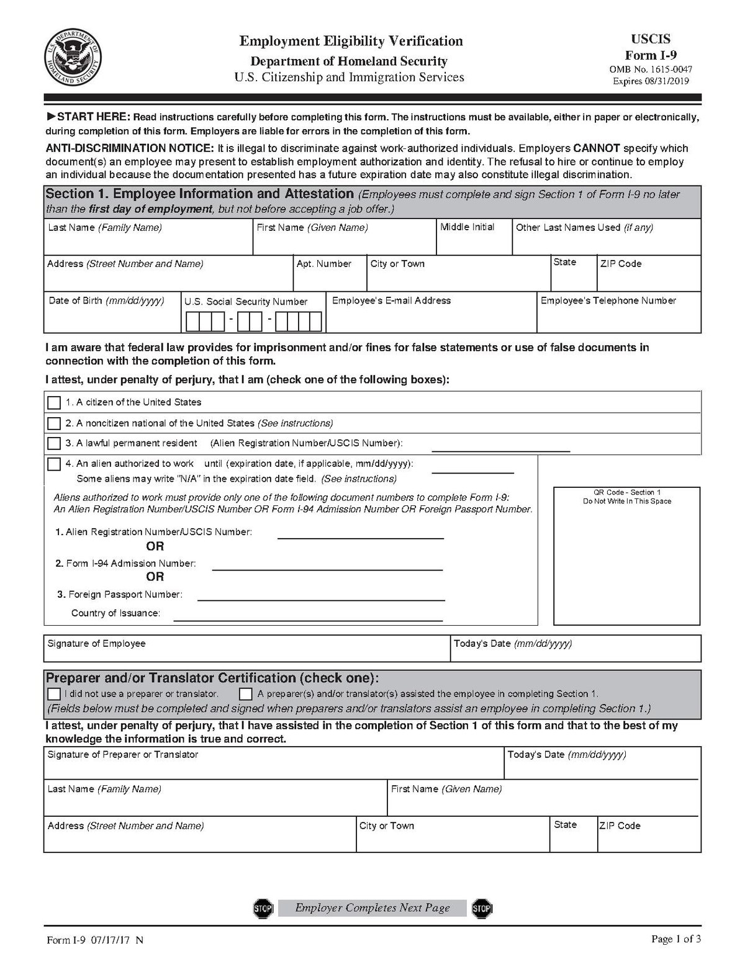
(1) establish both identity and employment authorization U.S. passport, permanent resident card, etc. (2) establish identity only driver’s license or photo ID card issued by a local, state, or federal government (3) establish authorization to work only Social Security card, certificate of birth, etc.
- The Supreme Court of the United States stated that states may enforce the use of E-Verify on all employers in a particular state under the constitution.

Slide 4
E-Verify
At first, employers examine these details that are submitted by every employee to determine whether these documents are genuine, authentic and relevant to the individual's identity.
All these Form I-9.If the data matches, the employee is eligible to work in the United States. If there is a mismatch, E-Verify alerts the employer, and the employee has eight work days to contact either the Social Security Administration or the Department of Homeland Security (depending on the source of the data mismatch) to start resolving the problem.
During this eight day period, and during the time it takes for the data mismatch to be further researched by the government agencies, the employee cannot be terminated.

Slide 5
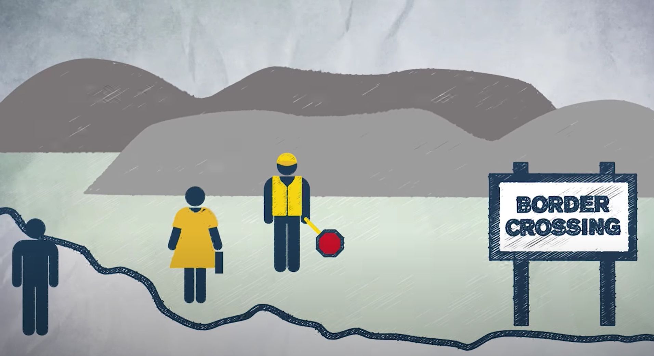
people illegally working, this takes away their jobs and wages
‘
Legal immigration

Slide 6
E-Verify
Even though the system was found to have some percentage of inaccuracy due to failure in identifying unauthorized workers, including some workers committing identity fraud, that has raised many political concerns and emotional responses.
In order to reduce those errors due to identity theft, the ICE recently implemented a photo tool that matches the photo submitted with the I-9 documents with photos in government records and with the actual employee.

Slide 7
E- Verify
In a 2011 ruling involving Arizona state law, the U.S. Supreme Court stated strongly that states may officially make use of E-Verify for all employers within a given state.
The states are greatly divided on this issue—some states have passed laws requiring all employers to use E-Verify to determine the eligibility of new hires; some just require public employers and government contractors to use E-Verify; and some require just private employers with more than a specified number of workers to use E-Verify. In some states, the decision to use E-Verify is being made at the county and city level.62
The number of employers who use E-Verify is increasing rapidly, almost doubling between 2010 (when 226,538 employers used the system) and 2012 (at which time 404,295 used it).63 An immigration bill proposed by the U.S. Senate in 2013 would require all companies with 500 or more employees to adopt E-Verify within three years.64

Slide 8
E- Verify
According to a 2010 analysis of E-Verify conducted by an outside consulting firm on behalf of the U.S. Citizenship and Immigration Services, 4.1 percent of initial responses from the E-Verify system were inconsistent with the worker’s actual employment eligibility status.
Of those erroneous responses, 0.75 percent related to workers who were initially determined to be not authorized to work but who were in fact authorized, and 3.35 percent related to workers who were determined to be employment authorized but who were not actually eligible to do so.65
By 2012, however, the percent of mismatches was down to 1.35 percent. Only 0.09 percent of employees were confirmed as eligible for employment after an initial mismatch, while 1.26 percent were found to be in fact ineligible.66

Slide 9
Highlighted Statistics from the Study In 2010, 4.1% were inconsistent with workers’ actual employment eligibility status, 0.75% was related to workers who were initially determined to have no right to work but were actually authorized, and 3.35% were related to workers who were determined to be authorized but actually Workers who are not qualified to do so are concerned.
However, by 2012, the proportion of mismatches had replaced 1.35%. After the initial mismatch, only 0.09% of employees were confirmed to be eligible for employment, while in fact 1.26% of employees were found to be unqualified.
In 2010 (the system was used by 226,538 employers at the time)
and 2012 (the system was used by 404,295 at the time)

Slide 10
E-Verify
One limit of E-Verify is that the system cannot detect all cases of identity fraud. In fact, the U.S. Immigration and Customs Enforcement (ICE) has conducted some of its largest raids of unauthorized workers at companies that use the E-Verify program. In 2011, for example, ICE raided Howard Industries’ electrical transformer plant in Mississippi and found about 600 unauthorized workers, many of who had used identification data of someone other than themselves.
In addition to accuracy issues, there is concern that mandatory use of E-Verify will harm authorized workers and lead to discrimination. Opponents also fear it will create additional work for human resource departments in terms of updating personnel records, and initiating and following up on requests to various government agencies.
Meanwhile, proponents argue that the accuracy of the E-Verify system will improve over time and as further enhancements are made. They believe that it is fair to ask employers to do a quick check of each employee to ensure that they are hiring authorized workers. With the high level of unemployment, supporters of E-Verify believe that steps should be taken to ensure that jobs go to authorized workers.

Slide 11
Discussion Questions
Do you support the implementation of enhancements such as photo matching and access to additional government databases to improve the accuracy of the E-Verify system? Why or why not?
2. If you were the owner of a small business, would you use the E-Verify system to screen prospective workers? Why or why not?
3. Would you favor mandatory use of the E-Verify system at large corporations and government agencies? Why or why not?

Slide 12
Discussion Questions
Do you support the implementation of enhancements such as photo matching and access to additional government databases to improve the accuracy of the E-Verify system? Why or why not?
We do support such implementations, even though the system was found to have some percentage inaccuracy such as failure to identify unauthorized workers. Although initially it will be difficult for trying to improve the e-verify since it will create additional work for human resource departments in terms of updating personnel records, and initiating and following up on requests to various government agencies. However, the accuracy of the E-Verify system will improve over time and as further enhancements will be made by them.
Due to the capacity of e-verify for comparing large volumes of Form I-9 stored as records in U.S. government records for every employee, it is fair to ask employers to do a quick check of each employee to ensure that they are hiring authorized workers. The step for supporting the e-verify is for ensuring that jobs go to only authorised workers. This can reduce the many concerns such as harm to authorised workers and discriminations as well since the system & form I-9 filled-up details will be constantly monitored , updated and regularly checked by the employers in the human resource departments.

Slide 13
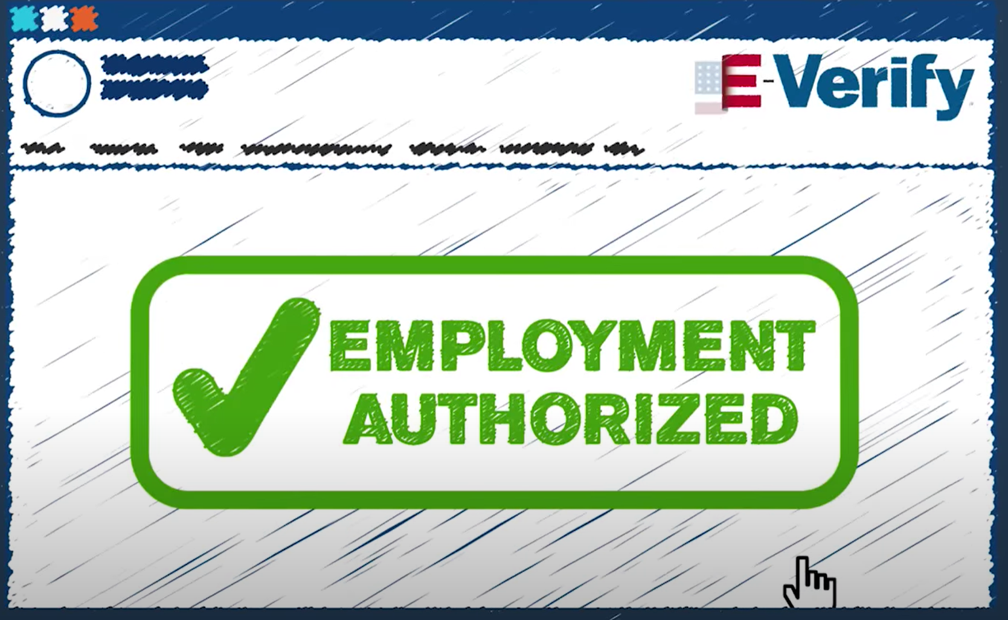
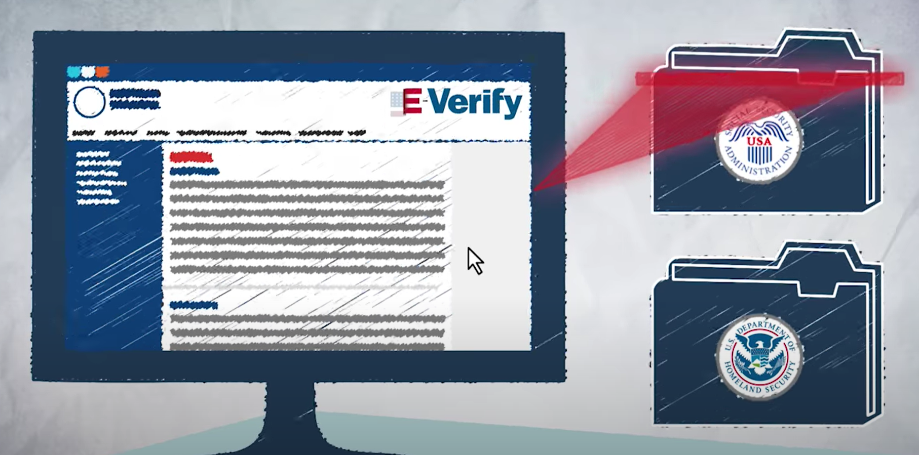
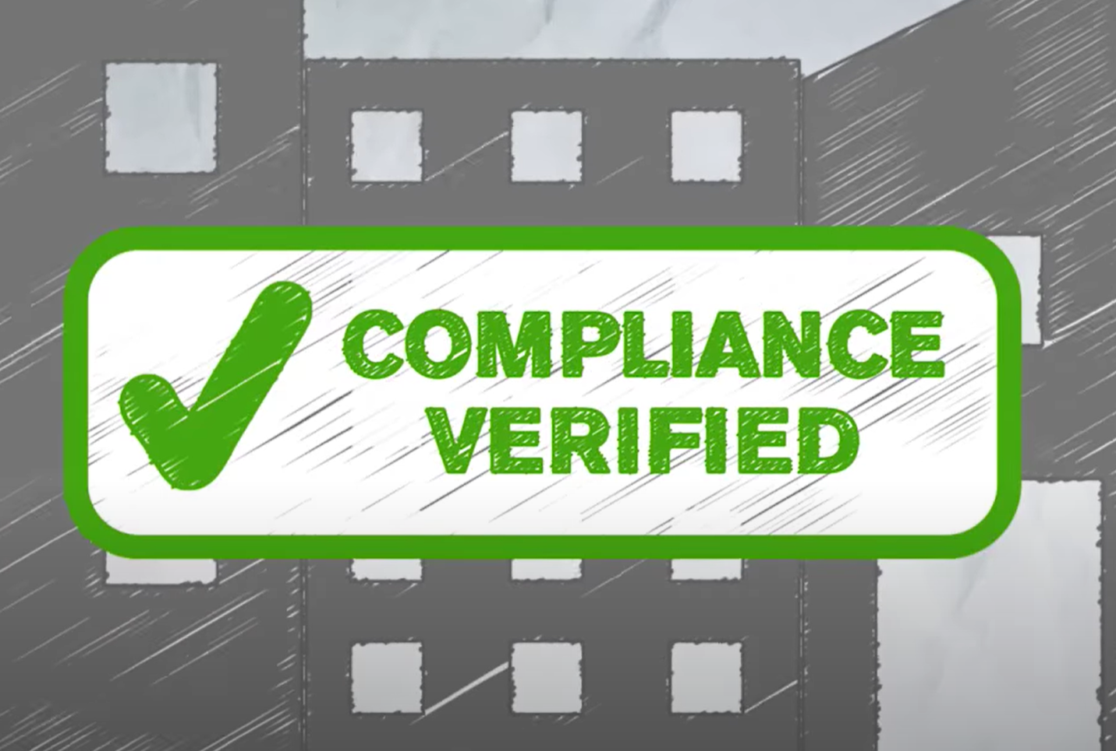
free
fast
accurate

Slide 14
Discussion Questions
2. If you were the owner of a small business, would you use the E-Verify system to screen prospective workers? Why or why not?
E-verify is used mostly for comparing large volumes of forms for a large number of employee. Small business would include small number of employees. An employer will not take much time to examine the details of the small number of employees for verifying whether the employees have the legal work permit or not. The employee can do it easily without e-verify. Therefore, the application of e-verify is not required for small businesses.

Slide 15
Discussion Questions
3. Would you favor mandatory use of the E-Verify system at large corporations and government agencies? Why or why not?
Yes, we can make the use of the e-verify system at large corporations and governement. Since e-verify has the capacity for comparing large volumes of data stored as records in the government record for every employee. Government or relevant large corporations tend to have a lot of employees. Otherwise, it's not posibble for employers to do a quick check of each employee to ensure that they are hiring authorized workers when asked. With the application of the e-verify system, it would be relatively convenient and easy for finding out immediately whether the employee is authorised legally for the job assigned whenever it's required to find out quickly about it.

Slide 16
Thank You

